Slide 1
SAP EWM EXTENDED WAREHOUSE MANAGEMENT TRAINING
AnubhavTrainings.com
www.anubhavtrainings.com

Slide 2

SAP EWM TRAINING
BY:-
Mr. Bijoy
www.anubhavtrainings.com
Notes:
https://unsplash.com/photos/uXB-7la5vqA

Slide 3
SAP EWM TRAINING (Day 06)
AnubhavTrainings.com

Slide 4
HU Management
Configuration involves both side (ERP & EWM) - Define Packaging Material types, Define allowed Pack material types, Material group for pack mat, HU types & related configurations, Number ranges for HU no.
Inbound process with HU Managed – testing execution

Slide 5
Ewm Ppf Actions
The SAP EWM PPF (Post Processing Framework) is a tool for the generic execution of functions and processes. It provides SAP Extended Warehouse Management (SAP EWM) a uniform interface for triggering actions, such as printing pallet labels, delivery docket, pick ticket, or sending messages or faxes.
The actions are generated if specific conditions occur for an application document. The SAP EWM PPF additionally provides triggering automatic subsequent documents and workflows. There is a status management and a processing log for every action.
Configuration Steps
Step 1: Check Action Profile assigned to Document Type (in this case Doc type – INB). Action profile assigned to Doc Type is “/scwm/pdi_01”
IMG > SCM EWM > Goods Receipt Process > Inbound Delivery > Define Document Types for Inbound Delivery Process

Slide 6
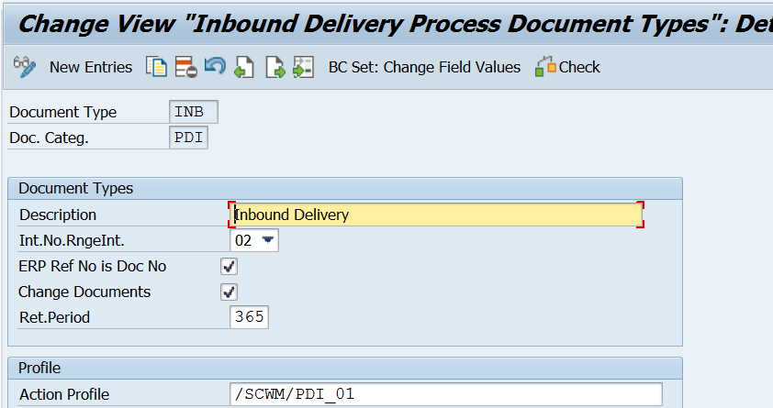
(Note – This is standard configuration should not be changed)

Slide 7
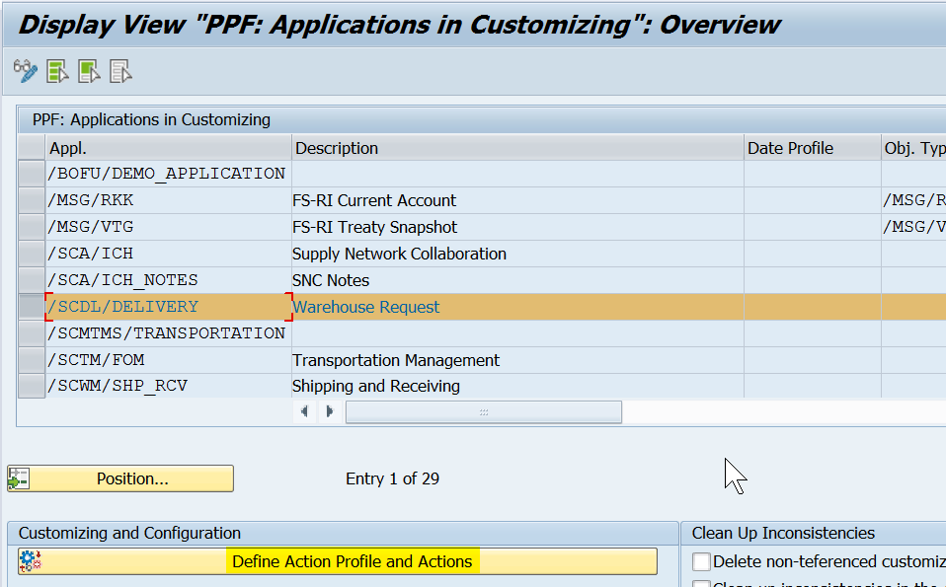
PPF APPLICATIONS (Tcode - SPPFCADM)

Slide 8
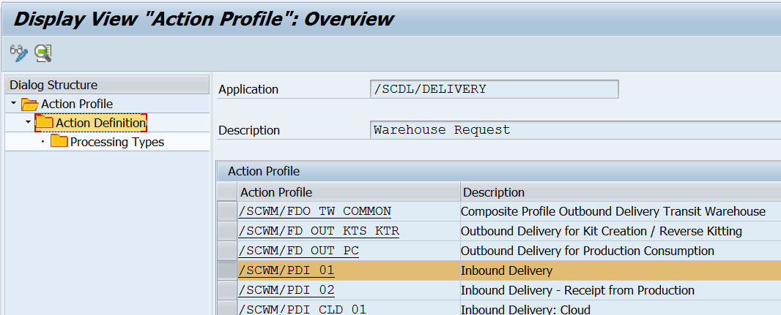
Click on Action Definition. There is one Action id defined as “/SCWM/PDI_01_WT_CREATE (Create Warehouse Task for Putaway)”. De-Select the inactive indicator.

Slide 9
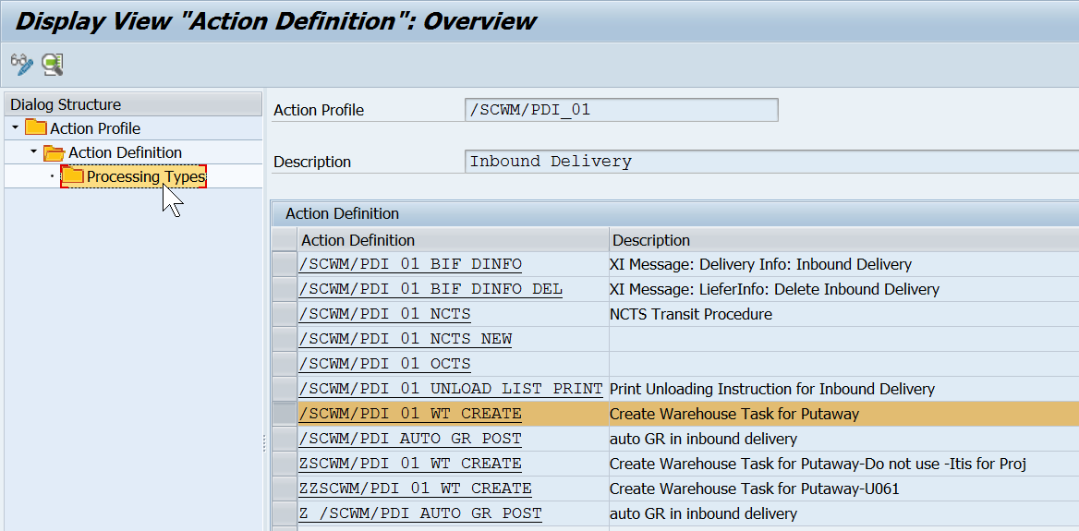

Slide 10
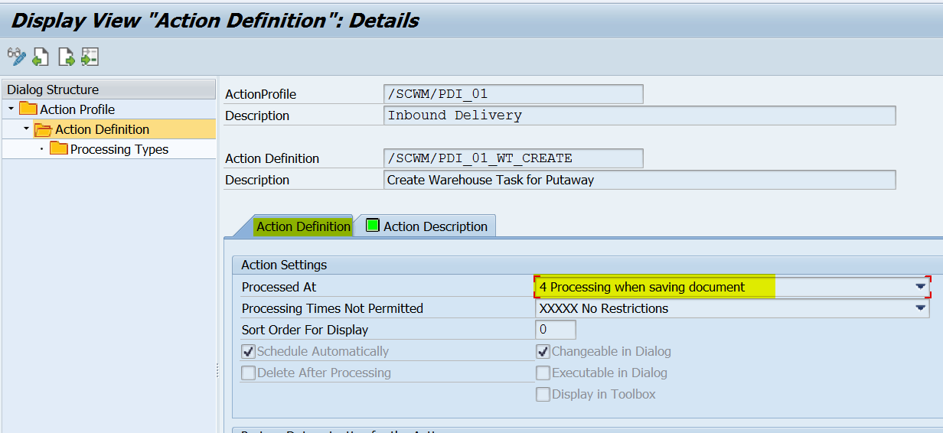
As you double click on same “Action Definition”, next screen pops up which shows that at what activity this action will be performed.

Slide 11
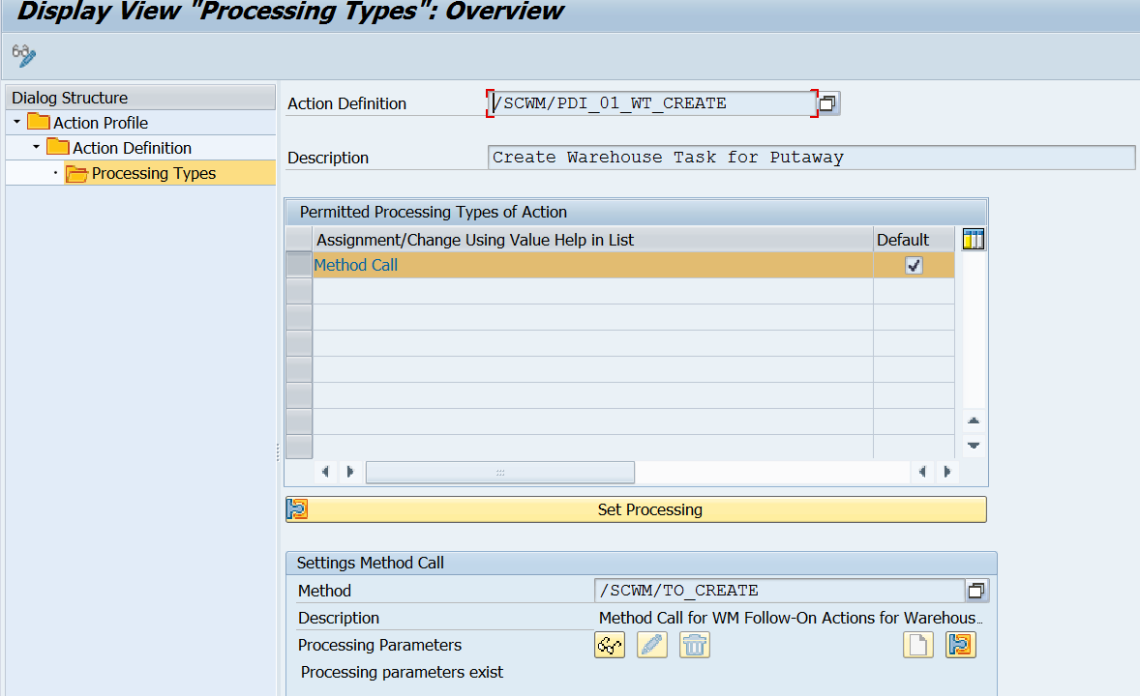

Slide 12
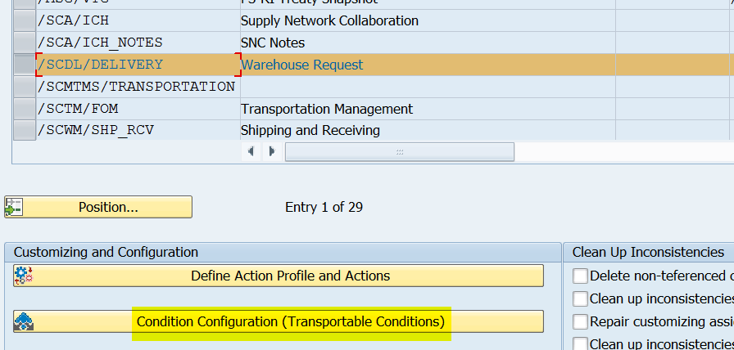
Condition Configuration
www.anubhavtrainings.com

Slide 13
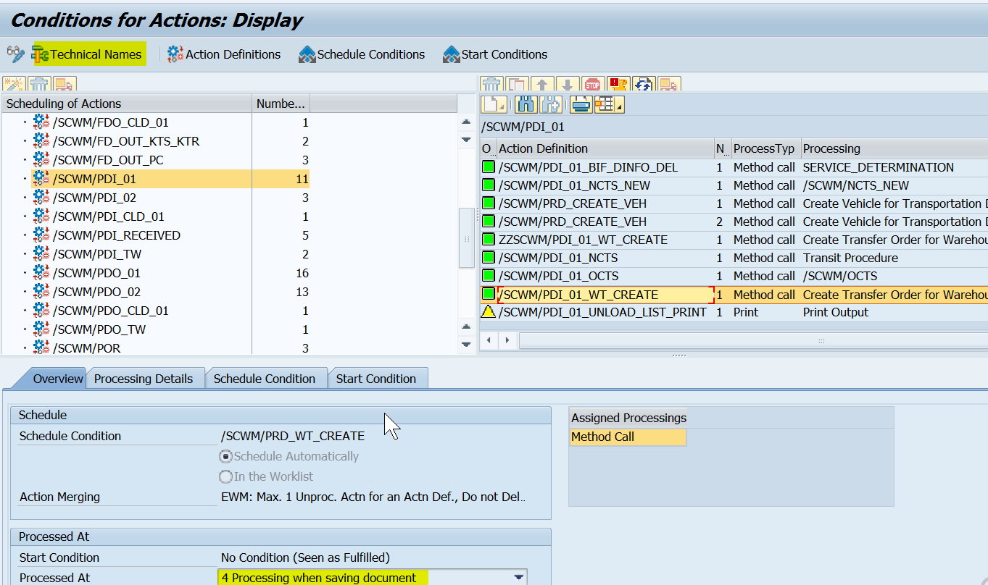

Slide 14
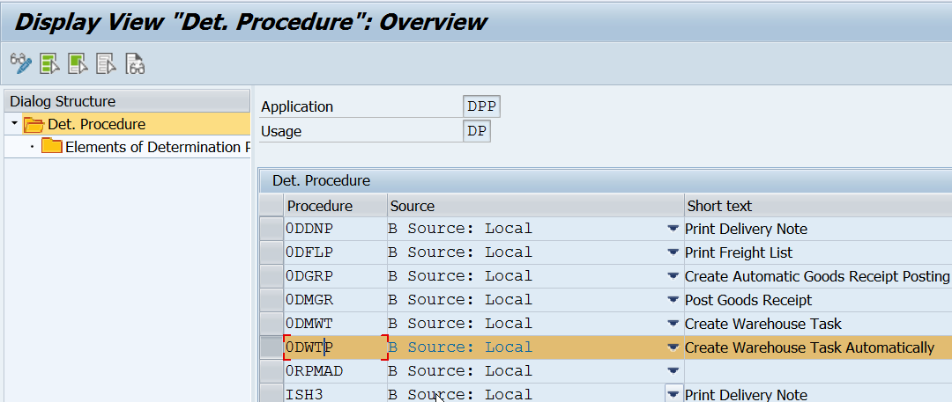
Configure Action Scheduling
IMG > SCM EWM > Cross Process Settings > Delivery- Warehouse Request > Action > Configure Action Scheduling > Maintain Determination Procedure
www.anubhavtrainings.com

Slide 15
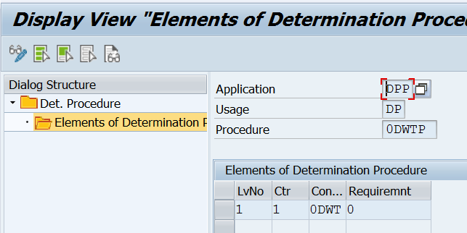
www.anubhavtrainings.com

Slide 16
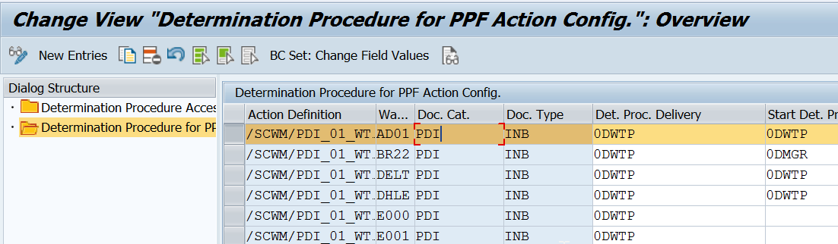
IMG > SCM EWM > Cross Process Settings > Delivery- Warehouse Request > Action > Configure Action Scheduling > Assign Determination Procedure

Slide 17
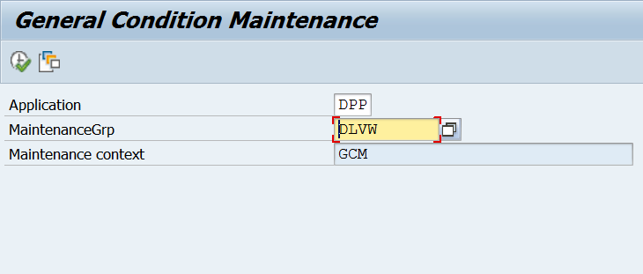
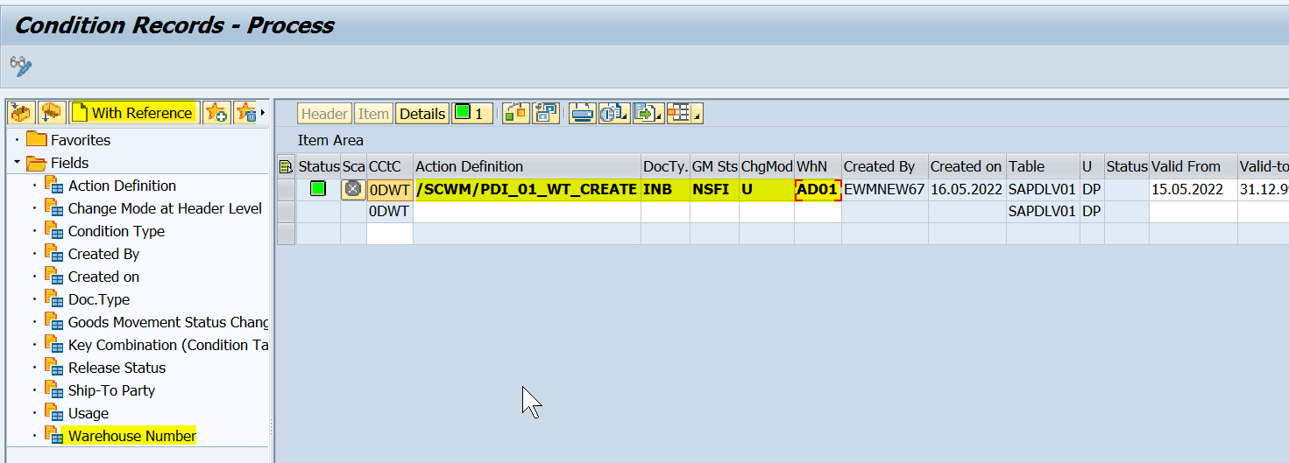
Maintain Condition Records
T-Code: /SCWM/DLVPPFC – Maintain Condition Records for PPF Schedule Conditions

Slide 18
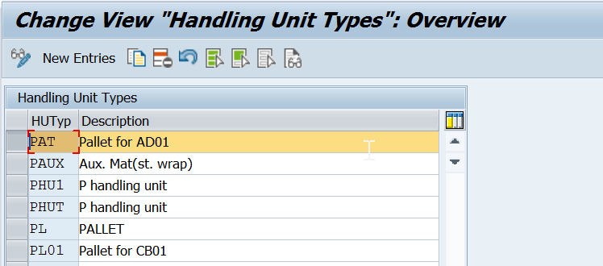
www.anubhavtrainings.com

Slide 19
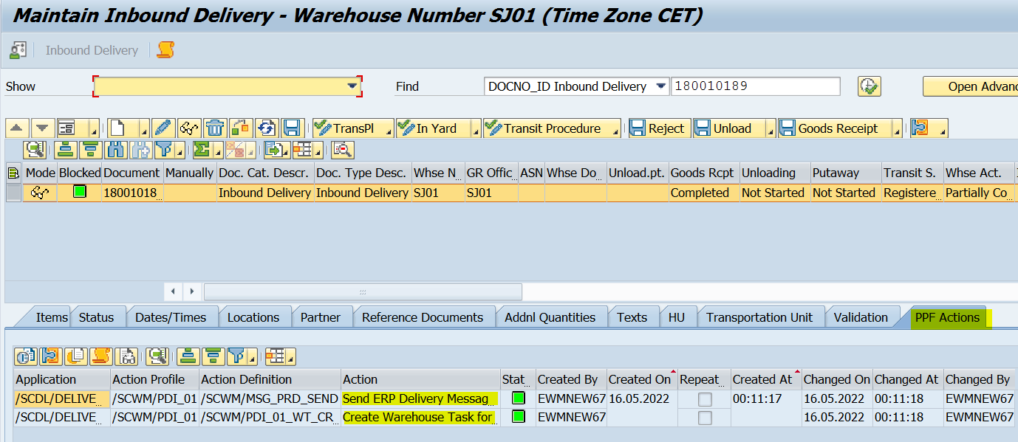
Testing Scenario for Automatic WT Creation
Once clicked on goods receipt, ppf actions will get triggered!
www.anubhavtrainings.com

Slide 20


End of Session 06
www.anubhavtrainings.com

Slide 21

FEEL FREE TO ASK QUESTIONS

Slide 22

Feedback

Slide 23
THANK
YOU

Slide 24

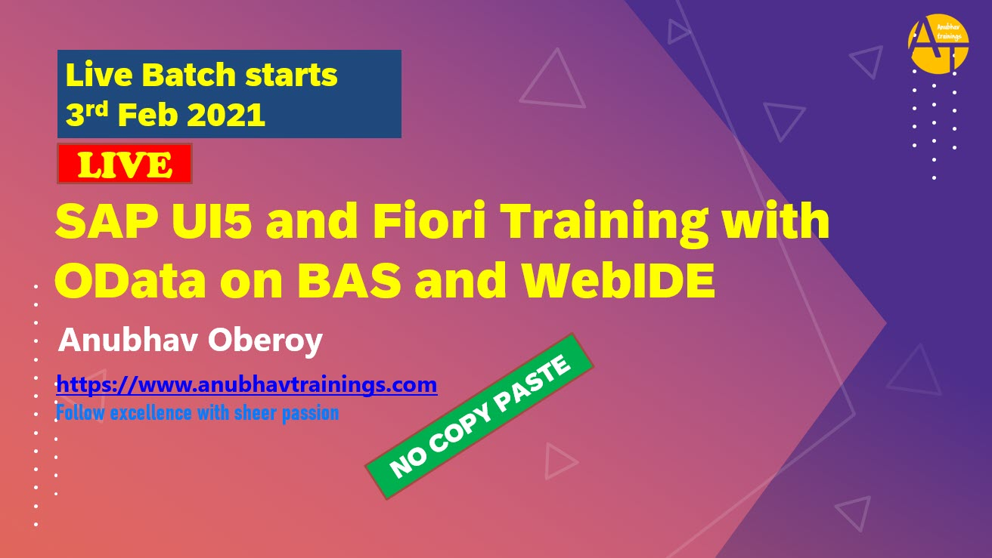

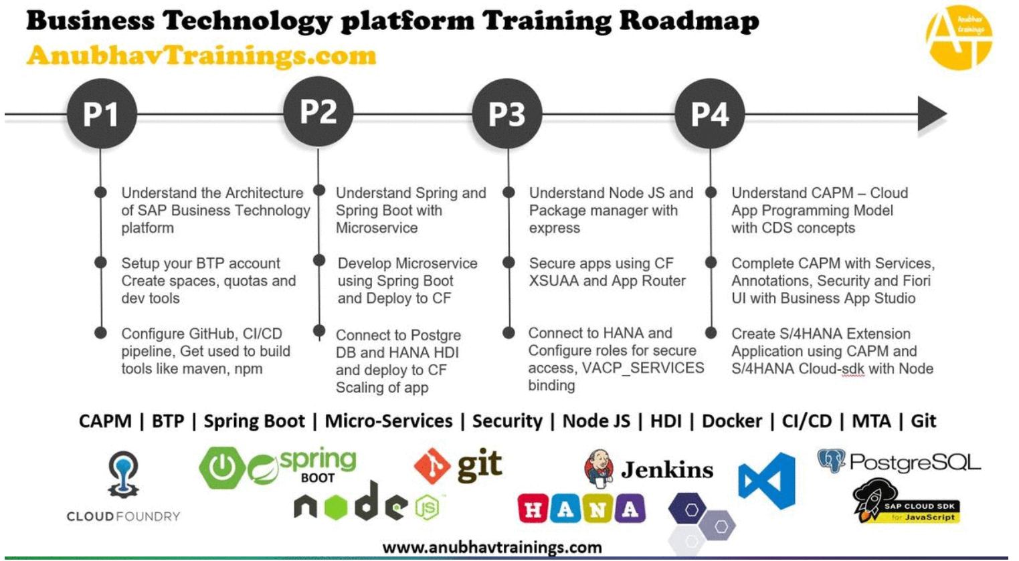
More from AnubhavTrainings.com

Slide 25






We’re committed to empower you to be
#FutureReady
through powerful training solutions.
We build the workforce of the future.
250+
Corporate Clients
30,000+
Learners Trained
25000+
Learners Placed
FREE WEBINARS
Sign up for free webinars with industry experts every fortnight!
Enroll Now!

Slide 26
FREE WEBINARS
Sign up for free webinars with industry experts every fortnight!
Contact us today!
www.anubhavtrainings.com

